Slide 1
A PROJECT ON Water level indicator by using ultra-sonic sensor

Slide 2
ABSTRACT:
Introduction-
A water level indicator is used to show the level of water in over-head tank, this keep the user informed about the water level at all time and avoids the situation of water running out when it is most needed. Indicator circuit also has alarm feature. It not indicates amount of water present in over-head tank but also gives an alarm when the tank is full.
Working Principle-
This Arduino space water level indicator uses an ultra-sonic sensor to determine the level of water in the tank. An ultra-sonic (well above human hearing) pulse is transmitted from the unit and distance-to-target is determined by measuring the time required for the echo return. Now the pulse corresponds to the distance to the target. This is then fed to the microcontroller that determines the water level and displays it through led.

Slide 3
INTRODUCTION:
In this Arduino based automatic water level and controlled project we are going to measure the water level by using ultrasonic sensor. Basic principle of ultrasonic distance measurement is based on ECHO. When sound waves are transmitted are environment then they return back to the origin as ECHO after striking on any obstacle. So we have to only calculate its travelling time of both sound means outgoing time and returning time to the origin after striking on any obstacle. And after some calculation we can get a result that is the distance. The concept is used in our water controlled project where the water motor pump is automatically turned on when water level in the tank becomes low.

Slide 4
COMPONENTS REQUIRED::
1.Arduino uno board
2.LCD display 16X2
3.Relay module
4.Buzzer
5.240V AC Supply Motor
6.Ultrasonic Sensor
7.Connecting wires
8.12V adaptor

Slide 5
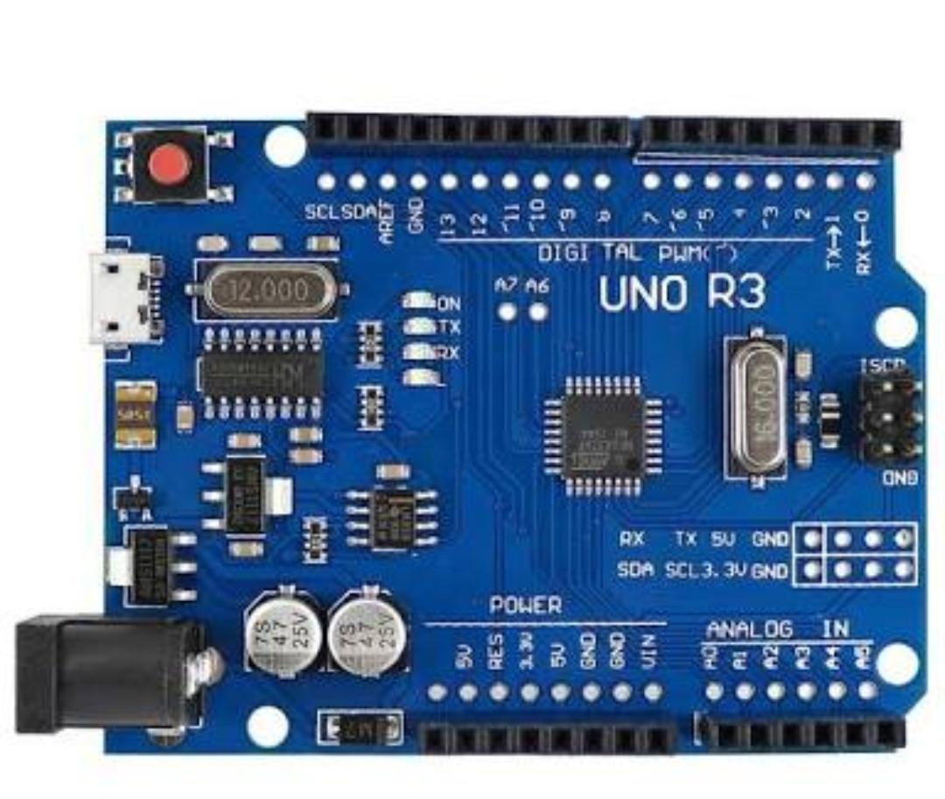
ARDUINO BOARD:
Arduino board is a widely used open source microcontroller board based on the Atmega 328P microcontroller and developed by Arduino cc.
The board is equipped with a set of digital and analog input /output pins that may be
Interfaced to various expansion boards and other circuits.
The board has 14 digital pins and 6 analog pins.
It is programmable with the Arduino IDE
with a type B Usb cable.
It can be powered by using
USB cable or a 12v battery.

Slide 6
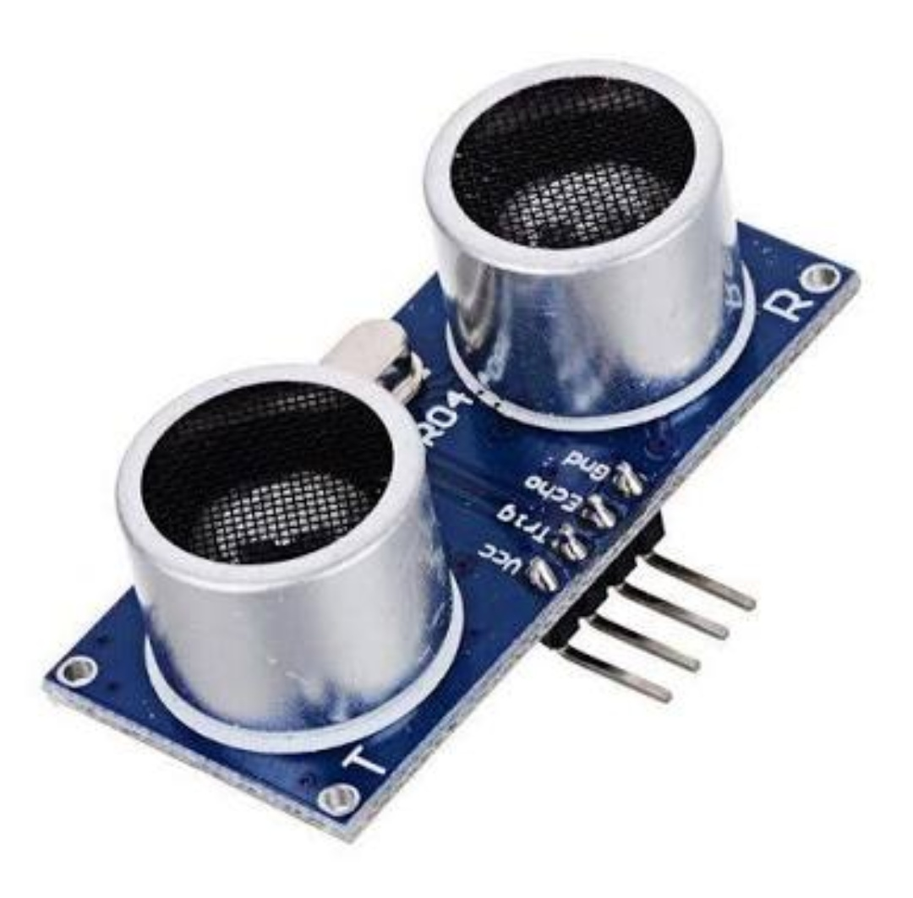
Ultrasonic sensor:
Ultrasonic sensor is used to measure distance in range of 2cm-400cm with accuracy of 3mm. The sensor module consists of ultrasonic transmitter, receiver and the control circuit.
The ultrasonic sensor module works on the natural phenomenon of ECHO of sound.
A pulse is sent for about 10us to trigger the module. After which the module automatically sends 8 cycles of 40 KHz ultrasound signal and checks its echo. The signal after striking with an obstacle returns back and is captured by the receiver.
Thus the distance of the obstacle from the sensor is
simply calculated by the formula given as
Distance= duration*340/2000

Slide 7
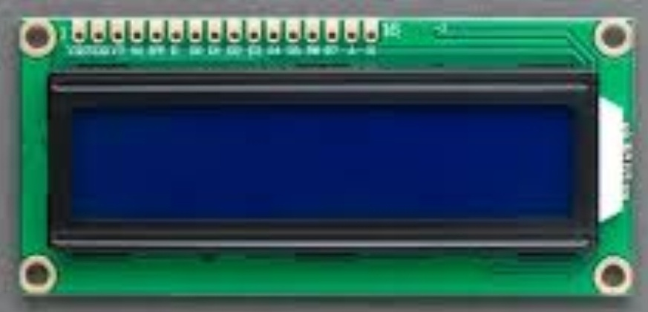
LCD display 16X2 :
A liquid-crystal display (LCD) is a flat panel dispaly or other electronically modulated output device that uses the light-modulating properties of liquid crystals.
Liquid crystals do not emit light directly, instead using a backlight or reflector to produce images in colour .
LCDs are available to display arbitrary images (as in a general-purpose computer display) with low information content, which can be displayed or hidden, such as present words, digits, and seven-segment displays, as in a digital clock. They use the same basic technology, except that arbitrary images are made up of a large number of small pixels, while other displays have larger elements.

Slide 8
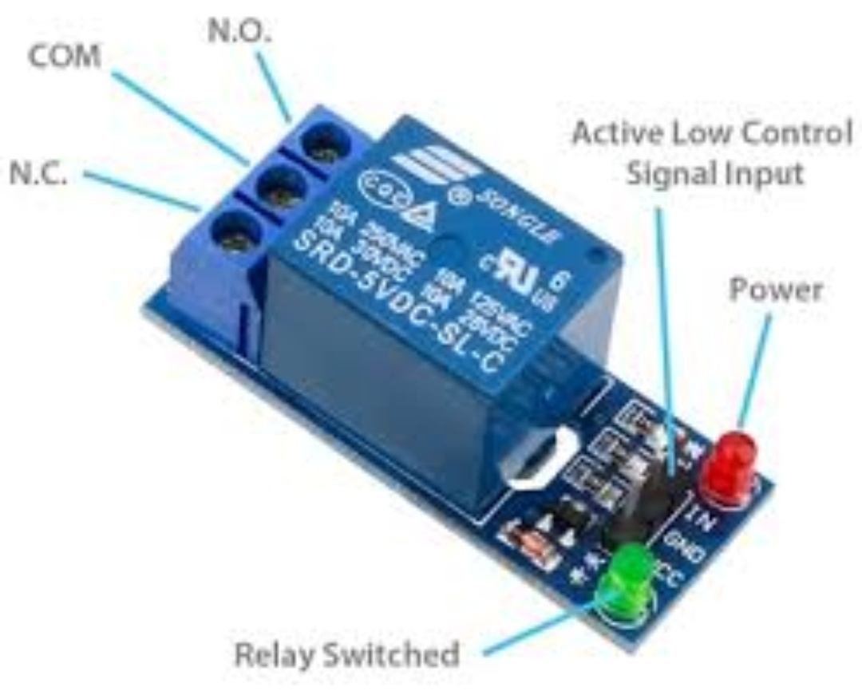
Relay Module-
A Relay is an electronic output device .
It is an electrically operated switch of mains voltage.
It means it can be turned ON or OFF ,
letting the current go through or not.
Controlling a relay with the Arduino is as controlling an output.
In relation to mains voltage,relay has 3 pins-
1.Common pin
2.Normally open
3.Normally closed

Slide 9
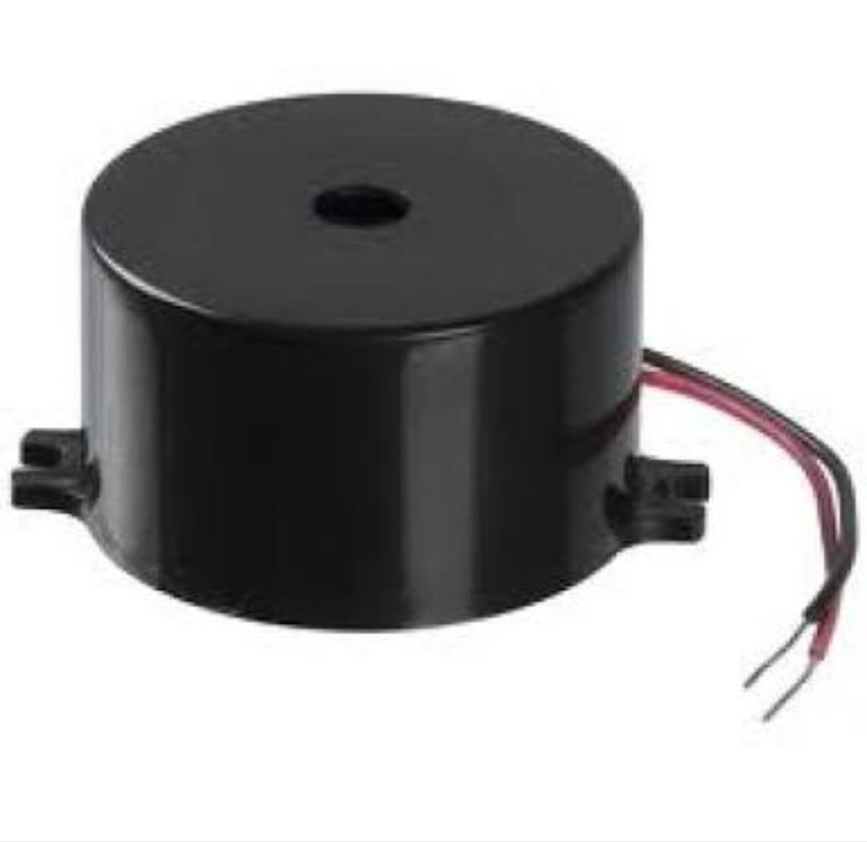
BUZZER-
Buzzer is an electronic output device .
Buzzer acts like a indicator to a person.
It has 3 pins
1.Ground pin 2.vcc pin 3.output pin
Typical uses of the buzzer includes alarm devices , timers , conformation of user input.

Slide 10
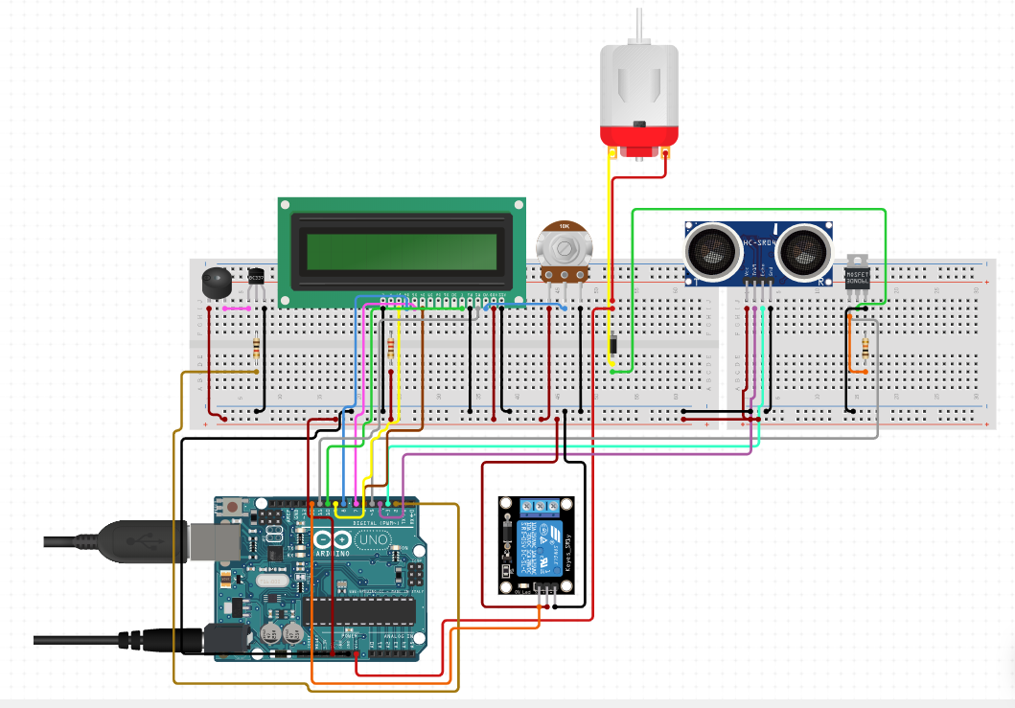

Slide 11
Circuit diagram explanation:
As shown in the given diagram,
Ultrasonic sensor module’s trigger and echo pins are connected to PIN 12&13.
In LCD display VSS to UNO GND,VCC to UNO 5V,VEE to UNO GND,RS to UNO PIN 11,R/W to UNO PIN 10,E to UNO PIN 9,
DB4,DB5,DB6,DB7 to UNO PIN 2,3,4& 5.
Relay module is connected to PIN 1 for turning ON &OFF the motor. BUZZER is connected to PIN 6.

Slide 12
Working procedure:
At the top of the tank ultrasonic sensor is placed,
Which sends the sound waves in the water tank and deflects reflection of sound waves that is ECHO. First of all we needs to trigger the ultrasonic sensor module to transmit signal by using Arduino and then wait to receive ECHO. Arduino reads the time between triggering and received ECHO. We can calculate distance by using the formula-
Distance=duration*340/2000.
By using this methods we gets distance from sensor to water source,then we calculate water level.
Now we calculate the length of water tank , then we calculate water level by subtracting resulting distance from ultrasonic from total length of the tank.

Slide 13
Code:
#include <LiquidCrystal.h> //http://www.arduino.cc/en/Tutorial/LiquidCrystal
LiquidCrystal LCD(11,10,9,2,3,4,5); //Arduino pin tied to pins of LCD display
int trigPin = 13; // Arduino pin tied to trigger pin on the ultrasonic sensor
int echoPin = 12; // Arduino pin tied to echo pin on the ultrasonic sensor.
void setup()
{
pinMode(1,OUTPUT); //Arduino pin connected to relay module as output
pinMode(trigPin,OUTPUT); //Arduino pin connected to ultrasonic sensor as output
pinMode(echoPin,INPUT); //Arduino pin connected to ultrasonic sensor as input
pinMode(6,OUTPUT);//Arduino pin connected to buzzer as output
LCD.begin(16,2);
LCD.setCursor(0,0);
LCD.print("Target Distance:");
}

Slide 14
void loop() {
int temp;
float duration,distance;
digitalWrite(trigPin,LOW); //output of trigpin
delayMicroseconds(2); //make delay of 2 microseconds
digitalWrite(trigPin,HIGH); //output of trigpin
delayMicroseconds(10); //make delay of 10 microseconds
digitalWrite(trigPin,LOW); //output of trigpin
duration=pulseIn(echoPin,HIGH); //output of echopin
distance = duration*340/20000; //formula of calculating distance
if(distance<4) //condition for motor off
{
digitalWrite(1,LOW); //output of relay module
digitalWrite(6,HIGH); //output of BUZZER
LCD.clear();
LCD.print("Water Tank full"); //display in LCD screen
LCD.setCursor(0,1);
LCD.print("Motor turned OFF"); //display in LCD screen
delay(500); //make delay of 500 microseconds
temp=1;
}

Slide 15
else if(distance<4&&temp==1) //condition for motor off
{
digitalWrite(1,LOW); //output of relay module
digitalWrite(6,HIGH); //output of buzzer
LCD.clear();
LCD.print("Water Tank full"); //display in LCD screen
LCD.setCursor(0,1);
LCD.print("Motor turned OFF"); //display in LCD screen
delay(500); //make delay of 500 microseconds
}
else if(distance>23) //condition for motor on
{
digitalWrite(1,HIGH); //output of relay module
digitalWrite(6,LOW); //output of buzzer
LCD.clear();
LCD.print("Water Tank Empty"); //display in LCD screen
LCD.setCursor(0,1);
LCD.print("Motor turned ON"); //display in LCD screen
delay(500); //make delay of 500 microseconds
temp=0;
}
}

Slide 16
Applications of Water Level Indicator:
The water level indicator is used in hotels, home apartments, commercial complex, and in factories.
We can measure the fuel level in motor vehicles.
We can also measure the liquid level indicator in the huge containers in the companies.

Slide 17
Team Number 8
Subudhi Anvesh – 17ECE123
D. Gouri Shankar – 17ECE004
Dilip Kumar Panigrahi – 17ECE122
Dinesh Kumar Patnaik – 17ECE108

Slide 18
THANK YOU

